Slide 1

Sistemi Wearable e Telemetria Medica
A.A 2024-25
(progetto di fine corso)
Wireless UHF RFID-Based Bladder Pressure Sensor
TASK 2
Prof. G. Marrocco
Tutor: Ing. Francesca Nanni
Laboratorio
Elettromagnetismo
Pervasivo
1

Slide 2
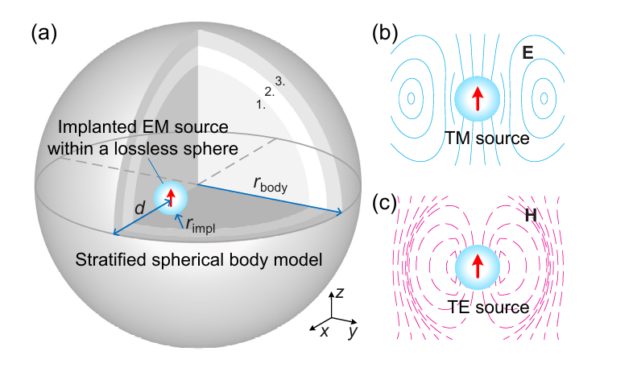
Physical Insights into Electromagnetic Efficiency of Wireless Implantable Bioelectronics
Mingxiang Gao, Denys Nikolayev, Zvonimir Sipus, and Anja K. Skrivervik
Hypothesis
Properties of body tissue are assumed isotropic, nonmagnetic (permeability μbody= μ0) and linear, i.e., E-field amplitude does not affect ε.
Source TE o TM surrounded by radius sphere rimpl.
Antenna matching has been adeptly executed by the antenna engineer.
The ohimic loss is not considered in the modeling because we regard the antenna mismatch losses as insignificant in comparison to the other losses investigated in this study.
If rimpl<< λbody and the implantation site is surrounded by thin layers → them have no significant effect on ηtotal.
Centered source and spherical symmetry of the model.

Slide 3

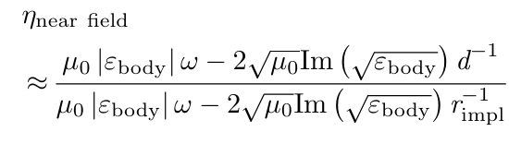
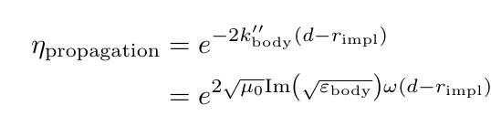
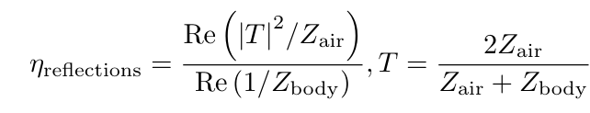

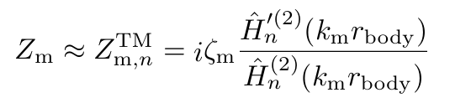
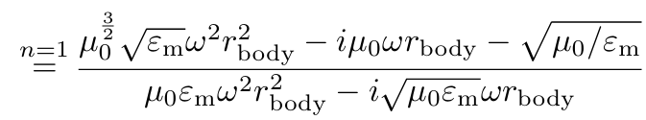
Formulas: TM sources
Since the radiation pattern of the implanted source is not disturbed by the surrounding body phantom, the obtained radiation efficiency can also be directly used to characterize the loss of wireless link or antenna gain caused by the body phantom in any direction. For a homogeneous spherical body model with a center source (rfeed = 0), specifically, the total radiation efficiency ηtotal could be expressed as:
For rbody >λm/2π:
For rbody <λm/2π:

Slide 4
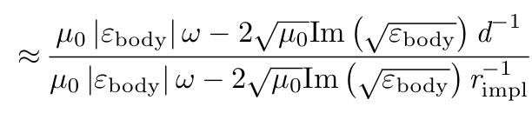

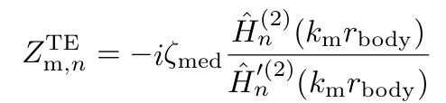
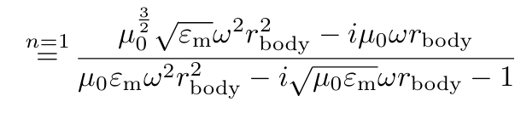

Formulas: TE sources
In the case of TE sources, some inevitable changes are required in the approximation of near-field loss and reflection loss.
For rbody ≤ λm/2π:

Slide 5

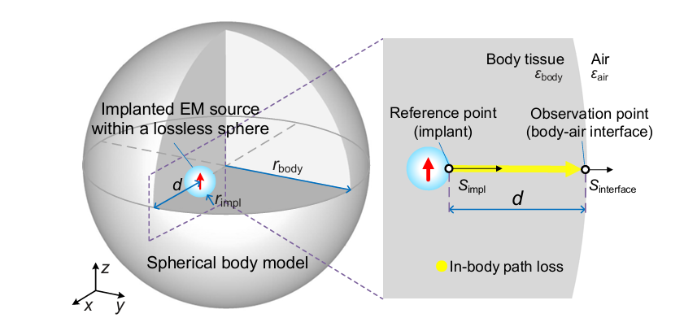
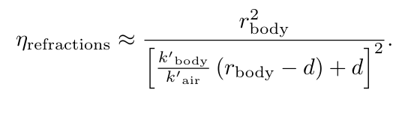
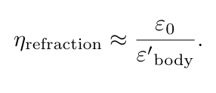
Formulas: Path Loss and Gain
It is possible to approximate the gain of an implanted source by extending the in-body path loss to the EM radiation reaching the far-field region in free space. To achieve this, another loss contribution, the efficiency due to refractions at the body-air interface ηrefractions. As a consequence, the gain of the implanted source can be expressed as:
For rbody → ∞:

Slide 6
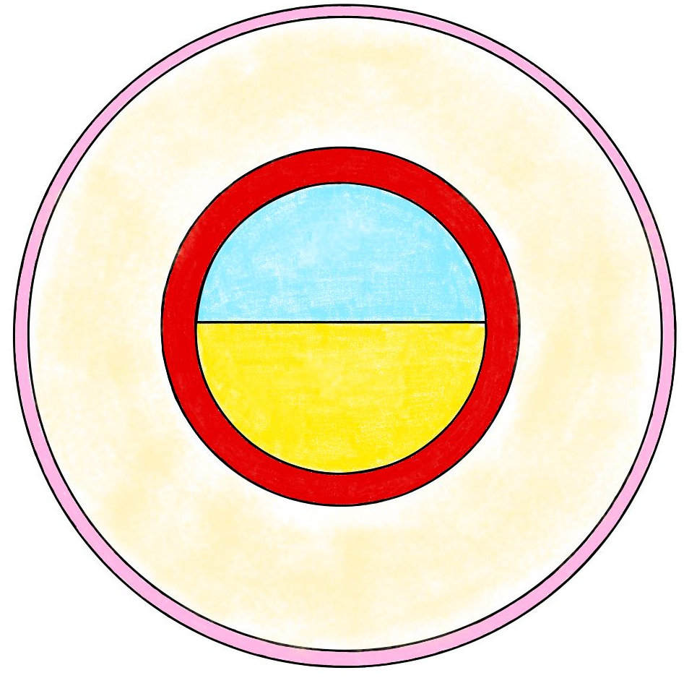
SIMULATIONS [1]: Floating Device
Dry Skin (0.2cm)
Hypotesis | Values
Frequency | 915 MHz
Rbody = d | 10.35 cm
Rimpl | 0.5 cm
Air (4.15 cm)
Fat (5cm)
Bladder (1cm)
Tissue Name | Relative Permittivity | Conductivity [S/m]
Air | 1 | 0
Bodyfluid | 68.898 | 1.6406
Bladder | 18.923 | 0.38506
Fat | 5.4596 | 0.051402
Dry Skin | 41.329 | 0.87169
Urine | 34.949 | 0.8203
Device (0.5cm)
Urine (4.15 cm)

Slide 7
SIMULATIONS [1]: Results
Assuming an antenna gain of 0 dB, the calculated efficiency values approximately represent the gain of the implanted source;
Efficiency trends were analyzed as Rimpl varied, using a weighted-average layered body model.
Results ηtot |  | TE source | TM source
Uniform body | Aritmetic mean | -21.7 dB | -25.6 dB
 | Weighted mean | -19.4 dB | -24.4 dB
Layered body | Aritmetic mean | -24 dB | -27.7 dB
 | Weighted mean | -22.15 dB | -27 dB

Slide 8
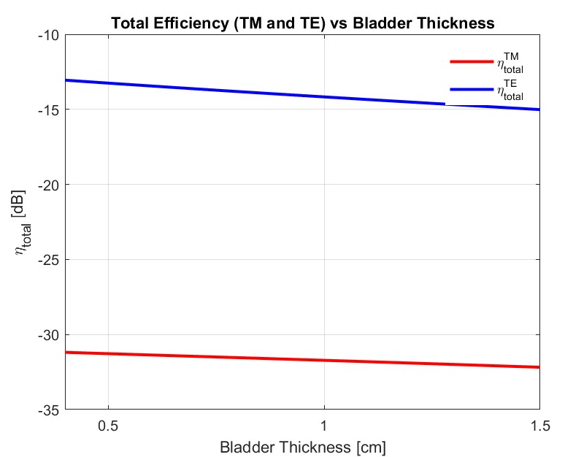
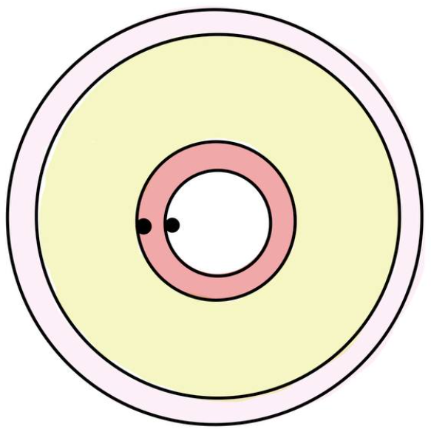
SIMULATIONS [1]: Intraluminal Device
The efficiency was analyzed as a function of depth within the bladder layer, using a layered body model with weighted-average properties.
Dry Skin (0.2cm)
Fat (5cm)
Bladder
Device (0.2cm)

Slide 9
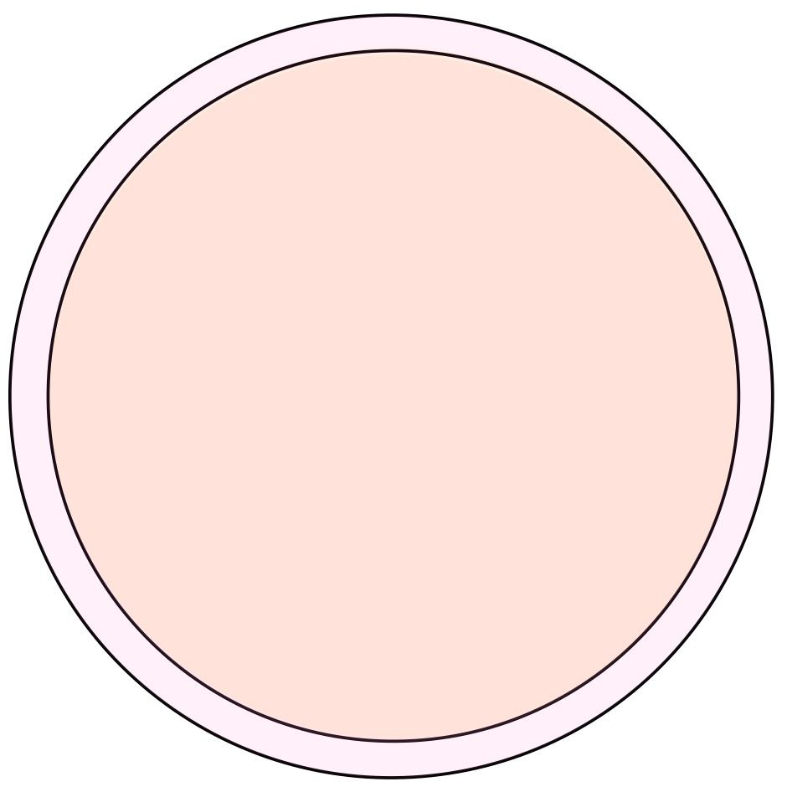
SIMULATIONS [2]: External Device
Hypotesis | Values
Frequency | 915 MHz
Rbody = d | 5.2 cm
Rimpl | 0.5 cm
Dry Skin (0.2 cm)
Fat (5 cm)
Tissue Name | Relative Permittivity | Conductivity [S/m]
Fat | 5.4596 | 0.051402
Dry Skin | 41.329 | 0.87169
Device (0.5 cm)

Slide 10
SIMULATIONS [2]: Results
Results ηtot |  | TE source | TM source
Uniform body | Aritmetic mean | -11.7 dB | -16.13 dB
 | Weighted mean | -5.6 dB | -15.4 dB
Stratified body | Aritmetic mean | -13.8 dB | -17.9 dB
 | Weighted mean | -9.3 dB | -18.7dB

Slide 11
SIMULATIONS [2]: Curious Results
Implantation Depth (d) variation in order to consider bladder movements during filling and voiding phases. Refraction efficiency should be considered.
Better efficiency with higher implantation depth? Maybe better not to consider refraction efficiency
rbody
d

